Slide 1
Lecture 1: Python Basics

Slide 2
Why Python?
a powerful, high-level programming language.
easy (for kids) to learn, easy-to-read, without a lot of experience.
becoming more and more popular.
one of the top 10 programming languages.
provides real skills for the future.

Slide 3
What is Programming?
A program is a detailed set of instructions telling a computer exactly what to do.
There are many different programming languages.
Java
C/C++/C#
Python
Javascript
Python can be used in lots of ways:
Building websites
Programming robots
Scientific computing
Games

Slide 4
What is Programming?
A program is a detailed set of instructions telling a computer exactly what to do.
There are many different programming languages.
Java
C/C++/C#
Python
Javascript
Python can be used in lots of ways:
Building websites
Programming robots
Scientific computing
Games

Slide 5
What are you going to learn?
You will learn how to solve problems using code.
You’ll start with simple visual puzzles, like drawing shapes on the computer screen.
You will learn how to create simple games like Guess a Number, Rock-Paper-Scissors, and Pong.

Slide 6
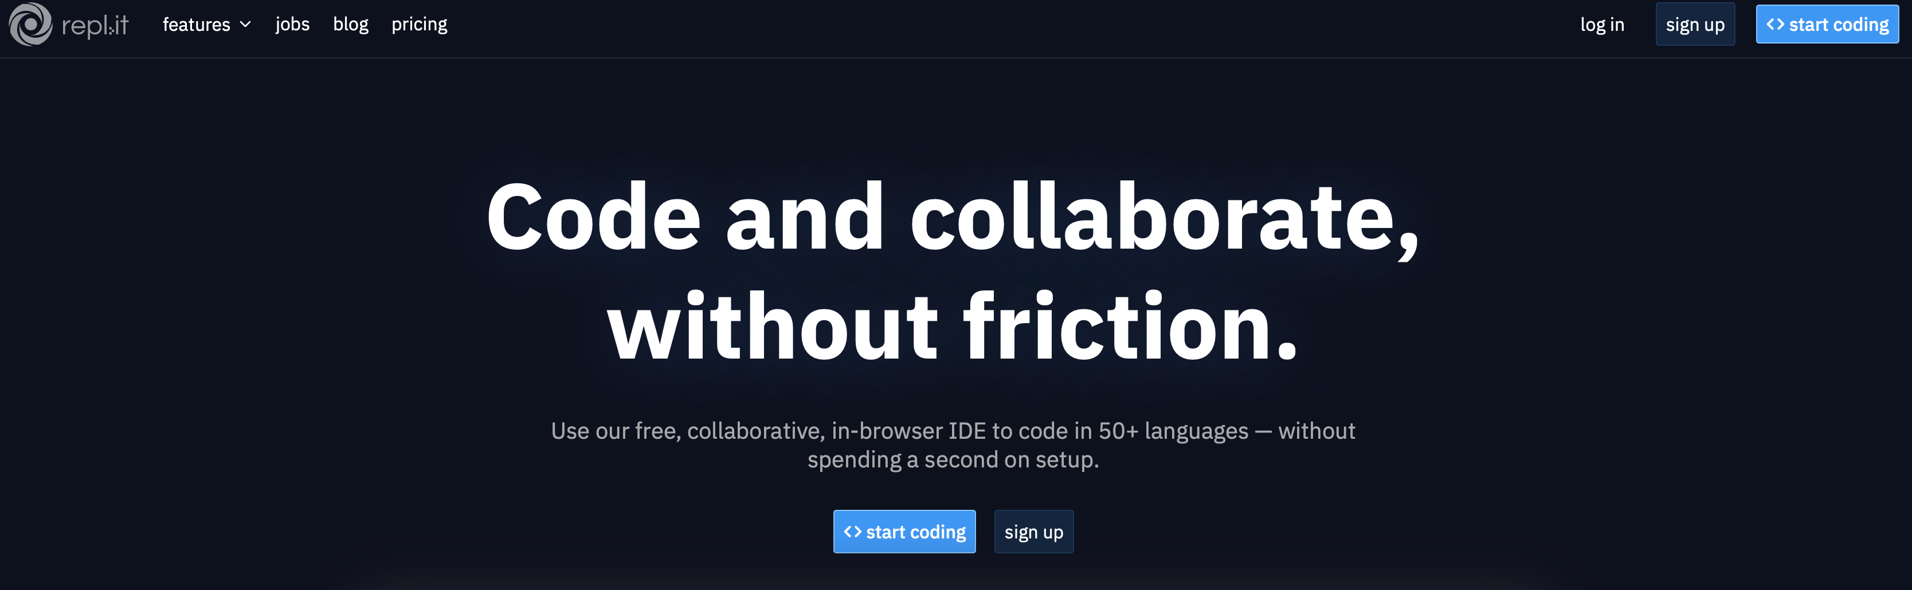
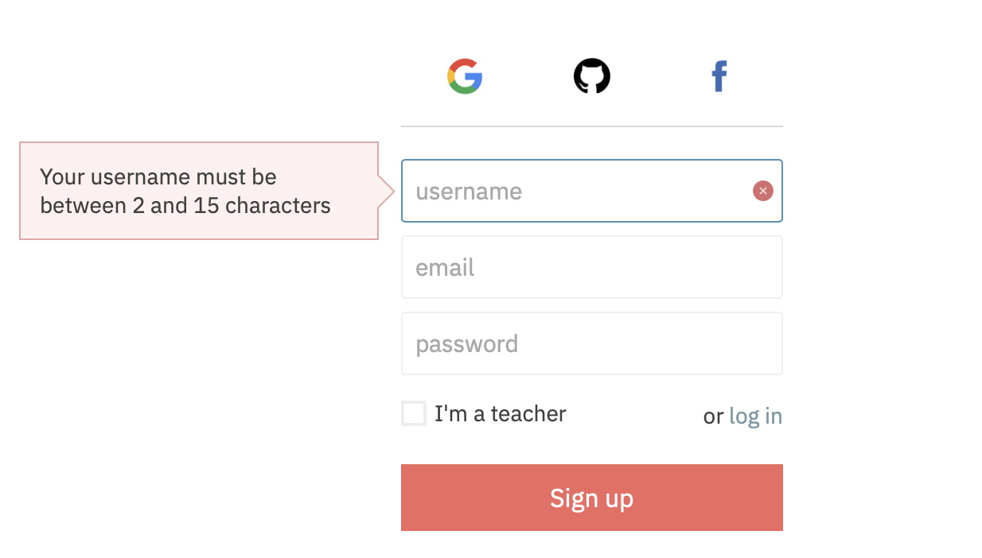
Set up an account on repl.it
Step 1: go to https://repl.it
Step 2: sign up
Ask your parents for help if you don’t have an email address
Remember/write down username and password

Slide 7
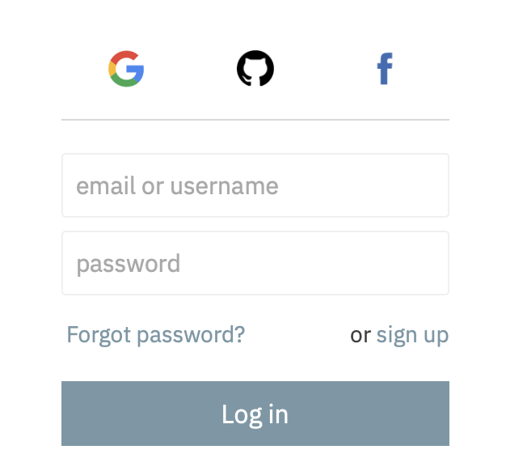
Set up an account on repl.it
Step 1: go to https://repl.it
Step 2: log in

Slide 8
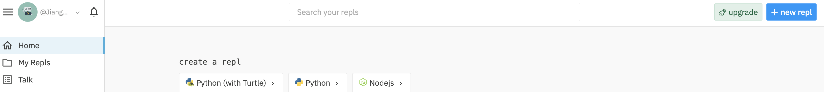
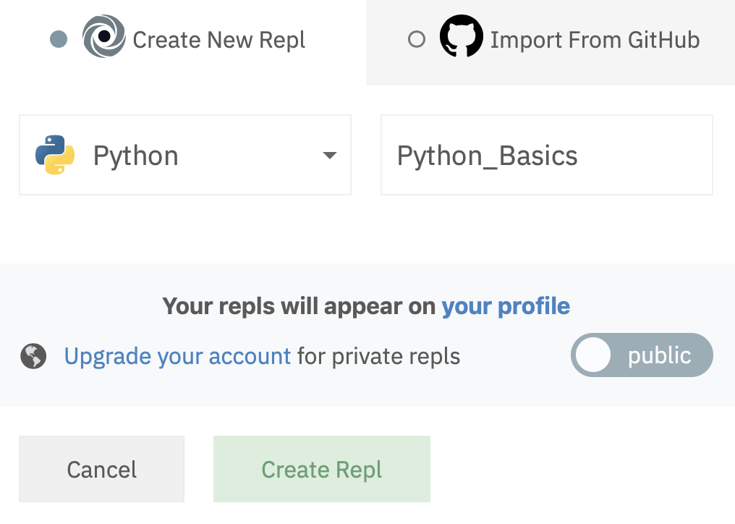
Run our code on repl.it

Slide 9
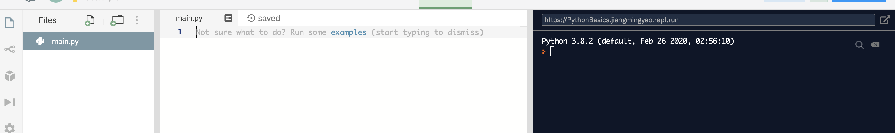
Run our code on repl.it
Congratulation!

Slide 10
Print a string
Try this out!
String: surrounded by either single quotation marks, or double quotation marks.
Example:
'hello' or "hello"
Print: print out (the value of a string) on screen.
print("Hello world")
print("Congrats!")
Question: which one is a string?
1) I am a string
2) “I am a string”
3) ‘I am a string’

Slide 11
Input() method
Try this out!
Input() method is a function that asks the user for input.
name = input("What’s your name? \n")
print("Hello", name)
string4age = input("How old are you? \n")
age = int(string4age)
print("Next year you will be", age + 1)
What’s your name?
Superman
Hello, Superman

Slide 12
Variables and Data type
Try this out!
Variables are containers for storing data values.
name = input("What’s your name? \n")
print("Hello", name)
string4age = input("How old are you? \n")
age = int(string4age)
print("Next year you will be", age + 1)
print(type(name))
print(type(string4age))
print(type(age))
A variable is created the moment you first assign a value to it.
Data type: string, integer, …
Text Type: | str
Numeric Types: | int, float, complex
What’s the difference between “10” and 10 ?
get the data type of any object by using the type() function

Slide 13
Change data type of variables
Try this out!
using constructor functions:
age = int(string4age)
print(type(string4age))
print(type(age))
x = str("s1") # x will be 's1’
y = str(2) # y will be '2’
z = str(3.0) # z will be '3.0'
int(): constructs an integer number from other data type.
float(): constructs a float number from other data type.
str(): constructs a string from from other data type.

Slide 14
Operators
Try this out!
Operators are used to perform operations on variables and values.
x = 5
y = 3
z = x + y
print(z)
- Assignment Operators
x = 5
y=3
assign values to variables
- common mathematical operations
Addition (+)
Subtraction (-)
Multiplication (*)
Division (/)
x + y

Slide 15
dictionary
Try this out!
A dictionary is a collection which is unordered, changeable and indexed. In Python dictionaries are written with curly brackets, and they have keys and values.
student = { "name": "Alice", "grade": 3, "year": 2020 } print(student)
- Create and print a dictionary
- Accessing Items
access the items of a dictionary by referring to its key name
x = student["name"]

Slide 16
Comments
Try this out!
Comments start with a hash mark (#), and Python will ignore them
print("Hello, World!") #This is a comment
- used to explain Python code.
- used to make the code more readable.
- used to prevent execution when testing code.
x = 5 # x is 5
y = 3 # y is 3
z = x + y # sum of x and y
print(z) # print out sum of x and y

Slide 17
Multi line Comments
#This is a comment #written in #more than just one line print("Hello, World!")
- To add a multiline comment you could insert a # for each line
""" This is a comment written in more than just one line """ print("Hello, World!")
- Or add a multiline string (triple quotes) in your code, and place your comment inside it

